Slide 1
#Factory Pattern
Intro
Hook
Explore
Explain
Apply
Share
Evaluate
Expand
Presenters:
Huỳnh Lê An Phú – 10421100
Phan Tâm Như - 10421122

Slide 2
#Table of Contents
Intro
Hook
Explore
Explain
Apply
Share
Evaluate
Expand
1. Overview
2. Implementation

Slide 3
The Pizza Factory overview
Intro
Hook
Explore
Explain
Apply
Share
Evaluate
Expand
Weather Station Device that receives the weather data
Weather Data Object Tracks the data from the station and updates
Display Show the current weather conditions

Slide 4
Factory Method
Intro
Hook
Explore
Explain
Apply
Share
Evaluate
Expand
Definition
The Factory Pattern defines an interface for creating an object, but lets subclasses decide which class to instantiate.
Factory Pattern is a creational pattern.

Slide 5
Abstract Factory
Intro
Hook
Explore
Explain
Apply
Share
Evaluate
Expand
Definition
Abstract factory pattern has creational purpose and provides an interface for creating families of related or dependent objects without specifying their concrete classes.
Abstract Factory is a creational pattern.

Slide 6
Factory Pattern
Intro
Hook
Explore
Explain
Apply
Share
Evaluate
Expand
When to use
A class wants its subclasses to specify the objects it creates.
A class don’t know the exact types and dependencies of the objects that it has to work with.

Slide 7
Abstract Factory
Intro
Hook
Explore
Explain
Apply
Share
Evaluate
Expand
When to use
When your code needs to work with various families of related products, but you don’t want it to depend on the concrete classes of those products.

Slide 8
Factory Pattern
Intro
Hook
Explore
Explain
Apply
Share
Evaluate
Expand
Pros and Cons
Can swap algorithms used inside an object at runtime.
Can isolate the implementation of an algorithm from the code that uses it.
Have to distinguish the differences between strategies to select a proper one.

Slide 9
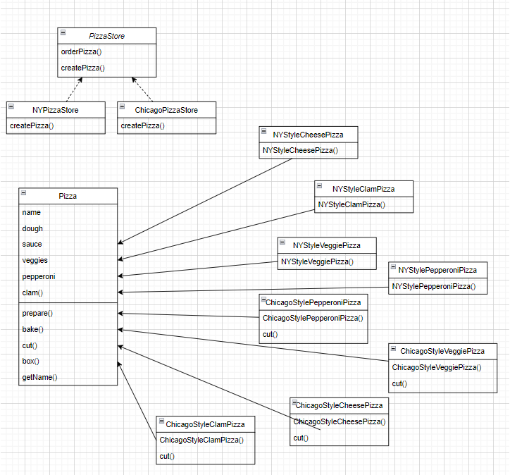
Intro
Hook
Explore
Explain
Apply
Share
Evaluate
Expand
Class Diagram
(Factory Pattern)

Slide 10
Description
Intro
Hook
Explore
Explain
Apply
Share
Evaluate
Expand
Create an application to manage the production of pizzas for a pizza chain store.

Slide 11
Implementation
Intro
Hook
Explore
Explain
Apply
Share
Evaluate
Expand

Slide 12
#Thanks!

